Slide 1
CSE 601: Distributed Systems
Toukir Ahammed

Slide 2
Architectural Styles

Slide 3
Architectural Styles
Important styles of architecture for distributed systems:
Layered architectures
Object-based architectures
Data-centered architectures
Event-based architectures

Slide 4
Architectural Styles
Layered Architectures

Slide 5
Layered Architectures
The basic idea for the layered style is simple:
Components are organized in a layered fashion where a component at layer L_{j} can make a downcall to a component at a lower-level layer L_{i} (with i < j) and generally expects a response.

Slide 6
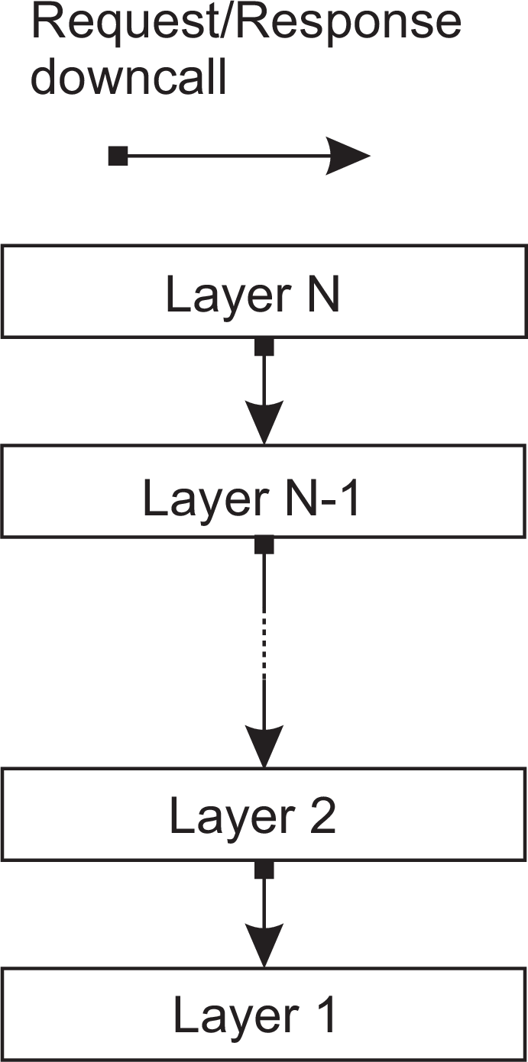
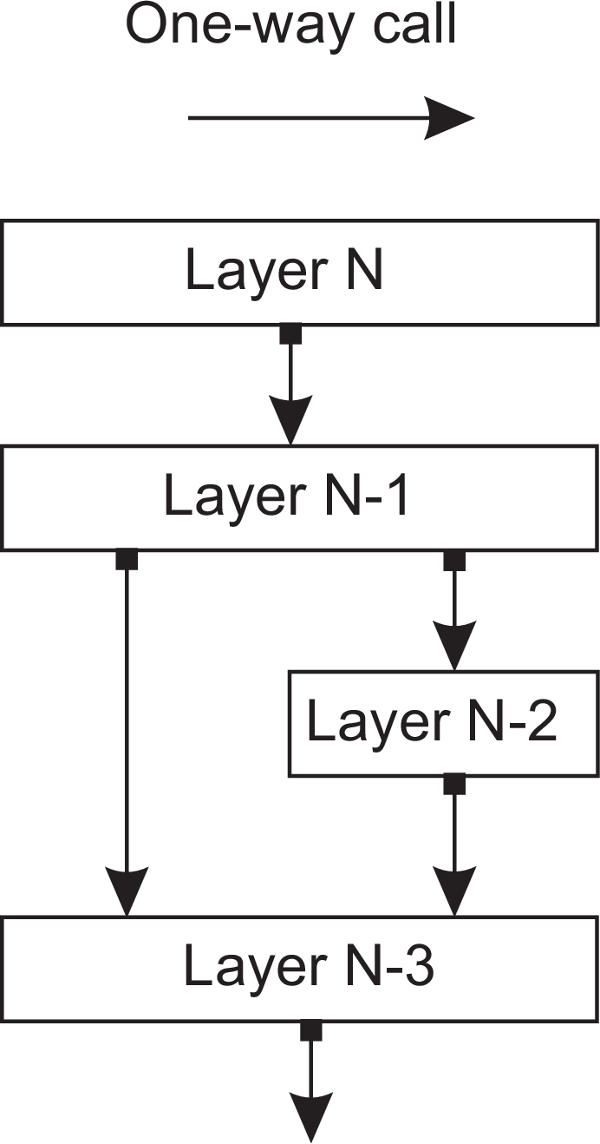
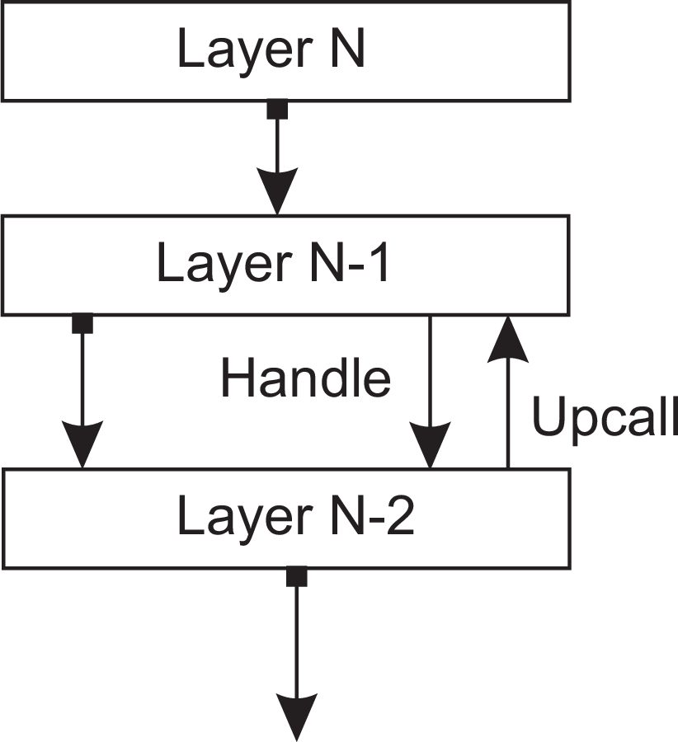
Layered Architectures
Different Layered Architecture
(a) Pure layered organization
(b) Mixed layered organization
(c) Layered organization with upcalls

Slide 7
Layered Architectures
Pure Layered Organization:
Only downcalls to the next lower layer are made.
This organization is commonly deployed in the case of network communication.
In TCP IP, there are 5 layers. (application, transport, network, link, physical) and you can only talk to the next one, not N-2.
Layer N-1 will provide an interface to N, and all communications must be conducted exclusively through this interface.

Slide 8
Layered Architectures
Mixed Layered Organization:
Consider an application A (N-1) that makes use of a library L_{OS} (N-3) to interface to an operating system.
At the same time, the application uses a specialized mathematical library L_{math} (N-2) that has been implemented by also making use of LOS (N-3)
In this case, A is implemented at layer N-1, L_{math} at layer N-2, and L_{OS} which is common to both of them at layer N-3.

Slide 9
Layered Architectures
Layered organization with upcalls:
A lower layer can make an upcall to its next higher layer.
A typical example is when an operating system signals the occurrence of an event, to which end it calls a user-defined operation for which an application had previously passed a reference (typically referred to as a handle).
N-1 is interested in event in N-2, so N-2 notifies N-1 that the event (handle) happened, using an upcall.

Slide 10
Application Layering
Traditional three-layered view
Application-interface layer (Presentation Layer) contains units for interfacing to users or external applications.
Processing layer contains the functions of an application, i.e., without specific data.
Data layer contains the data that a client wants to manipulate through the application components.
This layering is found in many distributed information systems, using traditional database technology and accompanying applications.

Slide 11
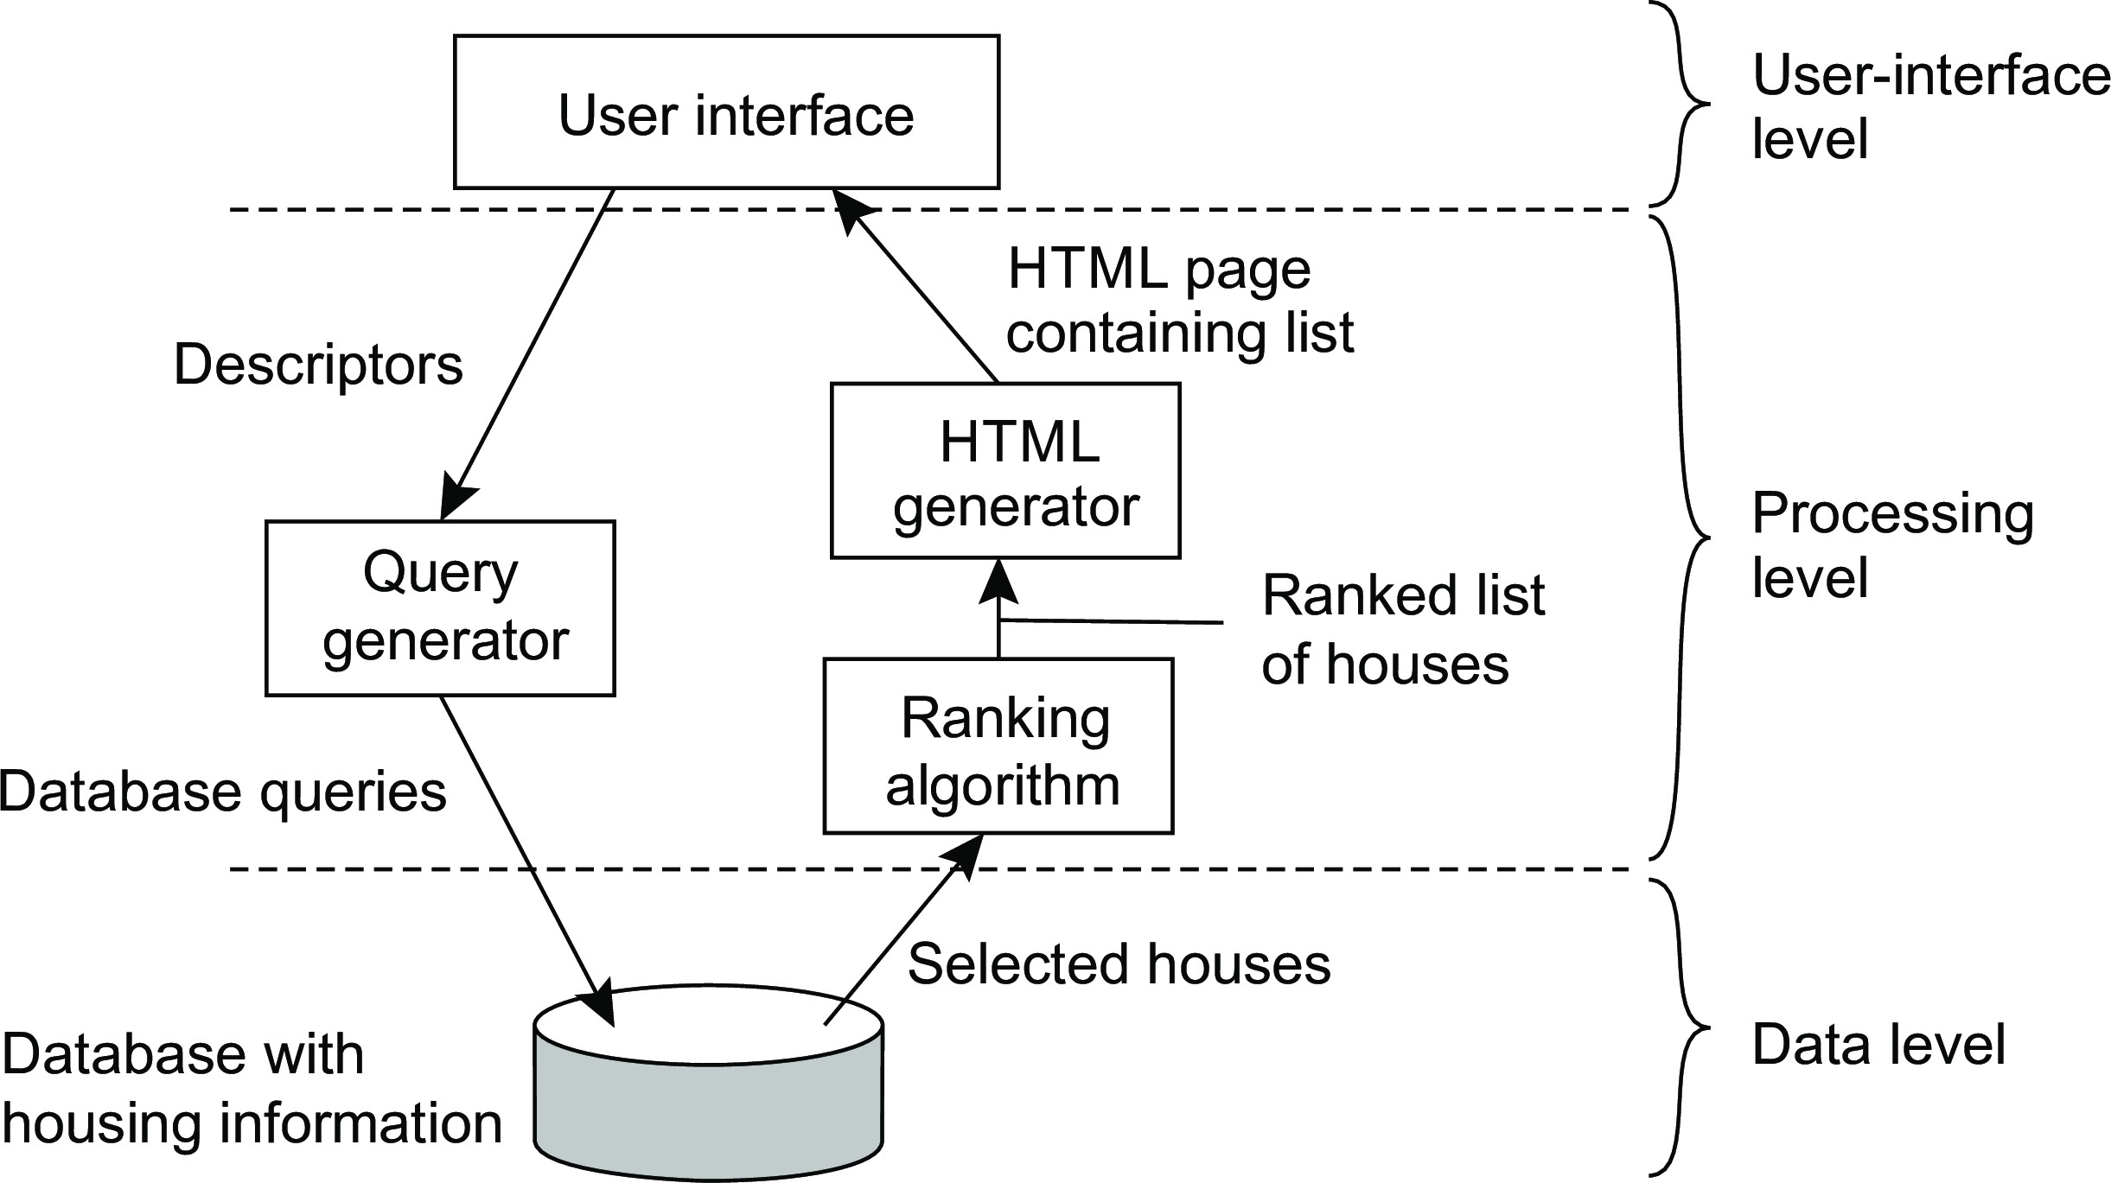
Application Layering
Example: A simple search engine

Slide 12
Architectural Styles
Object-based architectures

Slide 13
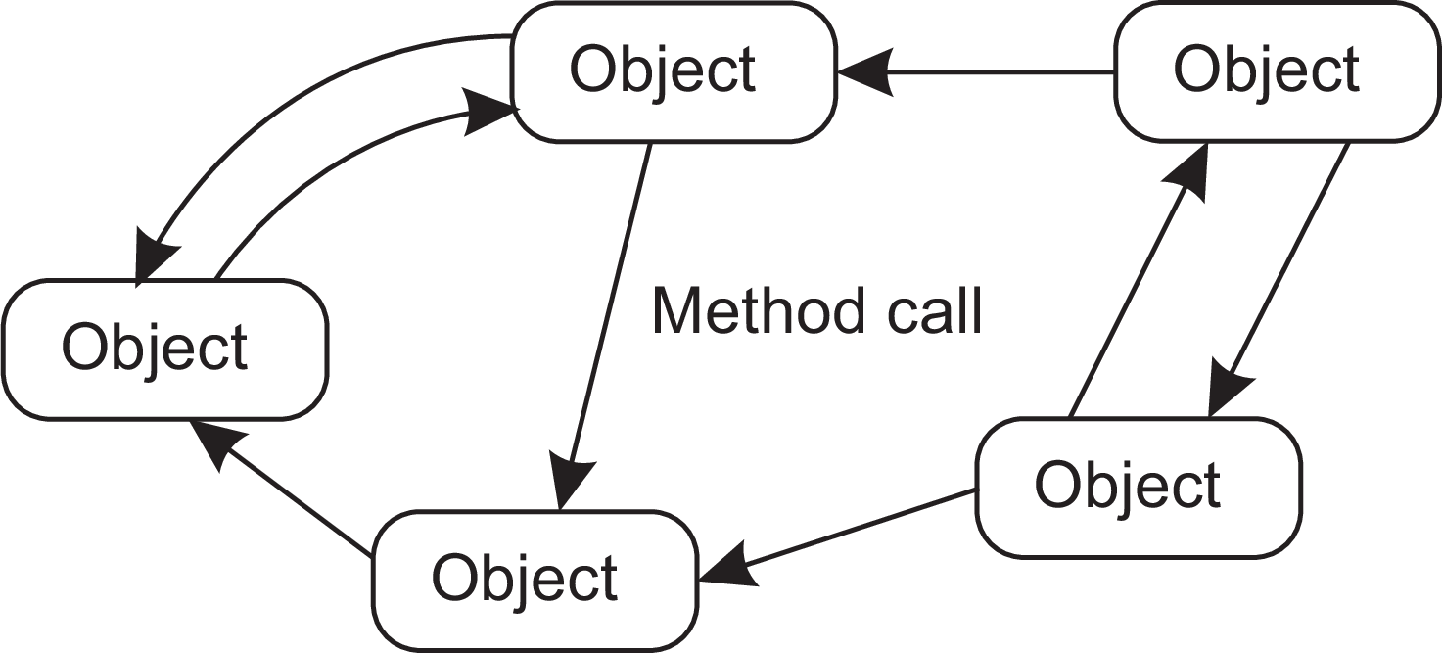
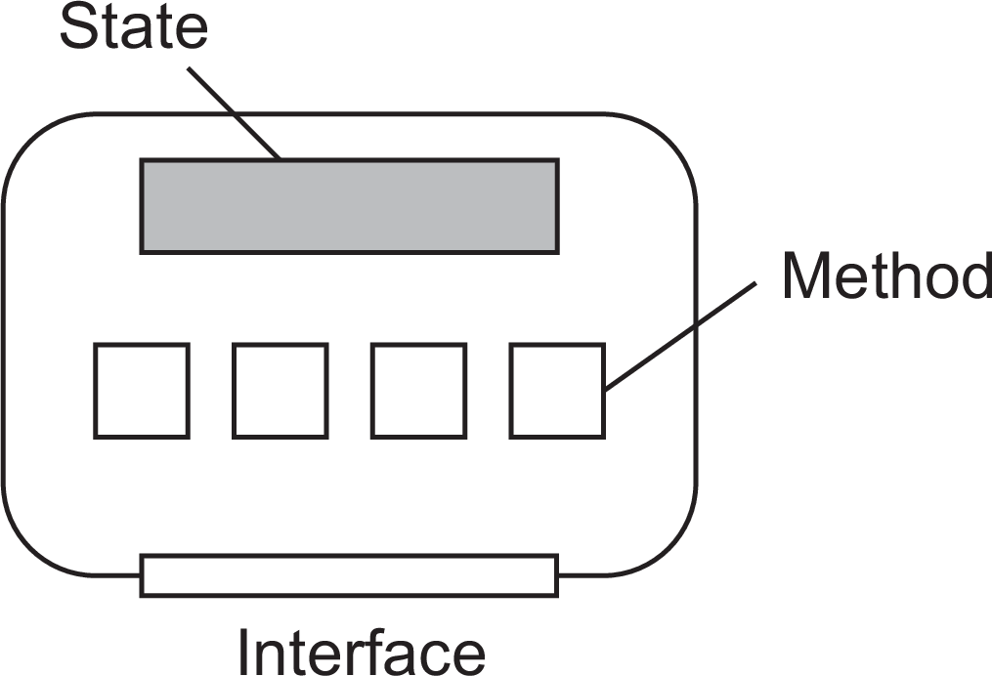
Object-based Architectures
Components are objects, connected to each other through procedure calls. Objects may be placed on different machines; calls can thus execute across a network.
Objects are said to encapsulate data and offer methods on that data without revealing the internal implementation.

Slide 14
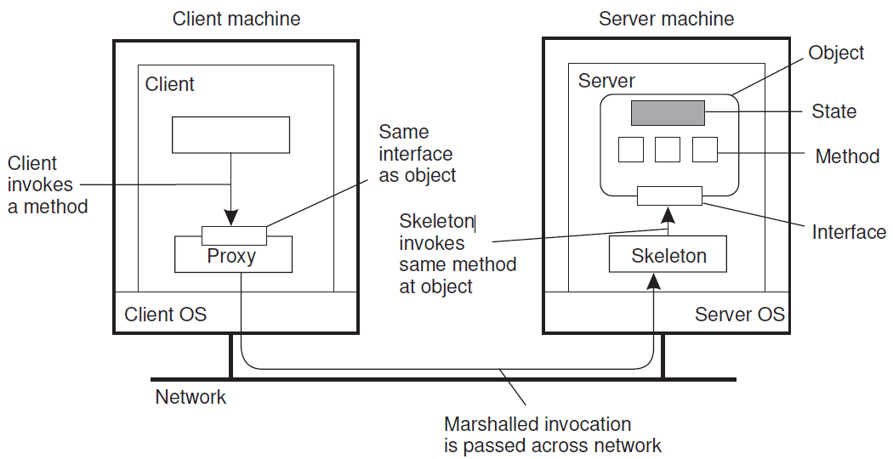
Object-based Architectures
Common organization of a remote object with client-side proxy.

